Slide 1

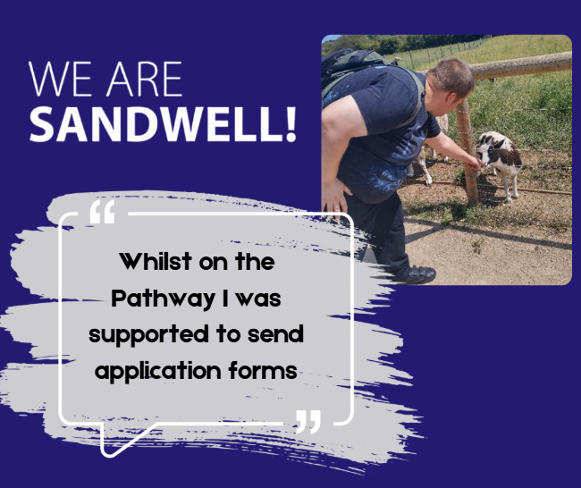

Case study: Luke’s Outreach Journey
May 2023
Luke receives support from our Outreach service. His goal is to seek paid or a volunteer role in the animal care sector so he that he can gain more knowledge and experience of working with animals.
Luke: “I am passionate about animals and all aspects of their health and wellbeing. I have had support to send application forms to different farms and zoos in Sandwell and the surrounding areas.”
He is currently awaiting a response for a volunteer role at a farm and has also been offered a week taster session at Birmingham Nature centre later this year. He is very keen to start a volunteer role when one becomes available at the Zoo.

