Slide 1
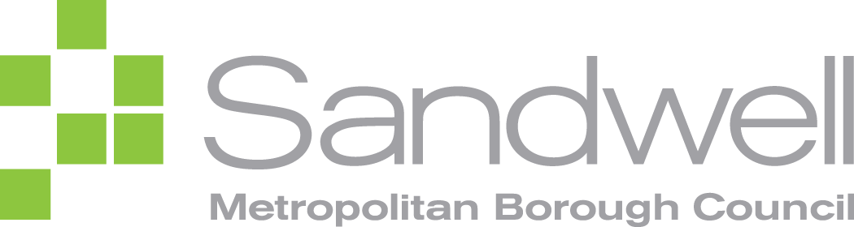
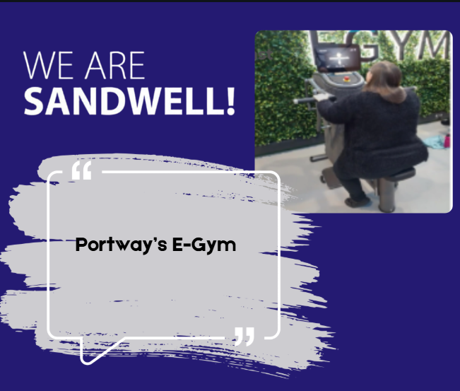
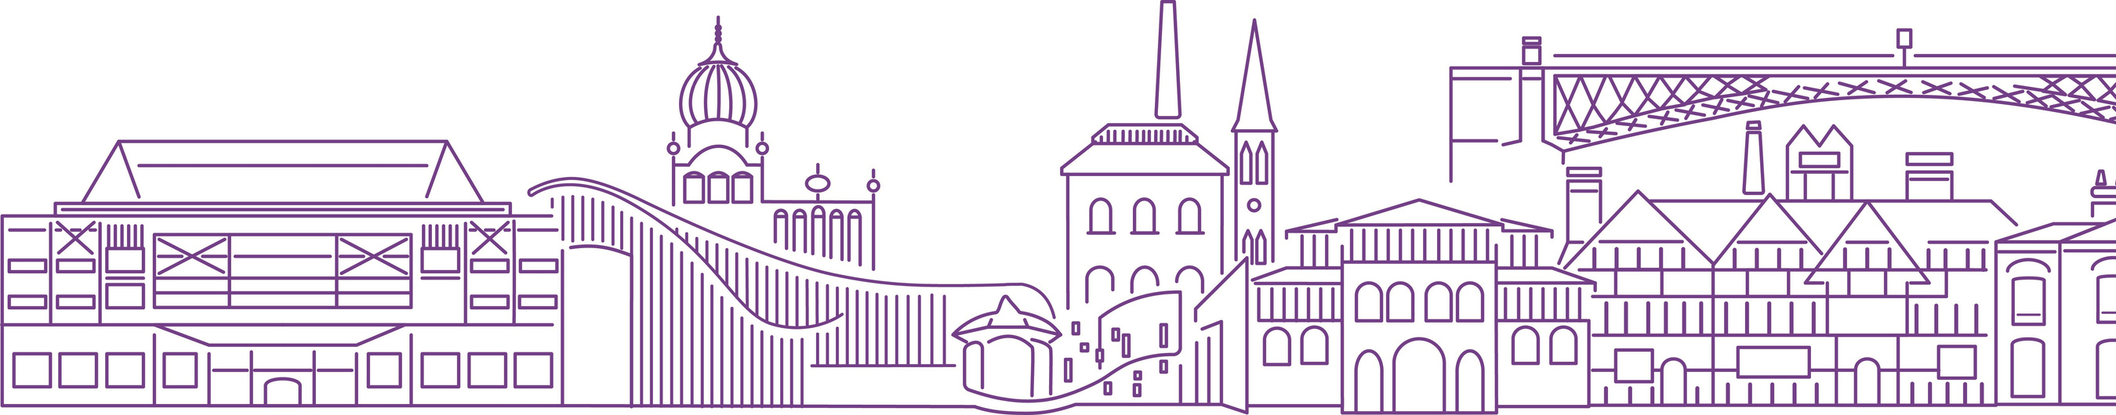
Case study: Portway’s E-Gym
March 2025
Welcome to the new E-gym!
This gym helps you get fit faster. No matter what your goal is getting stronger or looking better, you need a workout that works for you. This means changing things like how hard you push yourself, the weights you lift, how many times you do an exercise, and how fast you go.
The E-gym makes this easy by adjusting your workout to fit what you need. Sinead has moved from the Live Well Studio to the E-gym. She likes using the new machines with help from the staff. Sinead and the staff can also see how she is doing through an online app.

