Slide 1

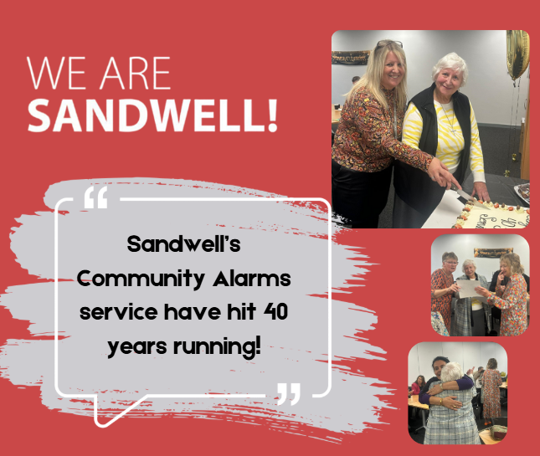

Case study: Community Alarms 40th
October 2023
The community alarm service has marked 40 years of service!
Offering support for people who could be vulnerable in their own homes since 1983, the service offers assistance at the touch of a button by wearing a pendant or wristwatch - preventing a situation from worsening or potentially preventing a hospital admission altogether.
Community Alarms offer a 24/7 service, 365 days a year and is available to anyone who needs it.

Slide 2
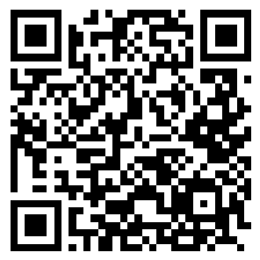
Case study: Community Alarms 40th
October 2023
Around 3,700 service users across the borough are supported to live more independently at home through their alarm packages:
628 carers supported through their carers’ emergency card scheme
Over 16,000 calls into the call handling team each month
98.6% of calls answered within 60 seconds
99% of calls requiring face to face support responded to within 45 minutes
Find out more about Community Alarms
www.sandwell.gov.uk/adult-social-care/community-alarms

