Slide 1

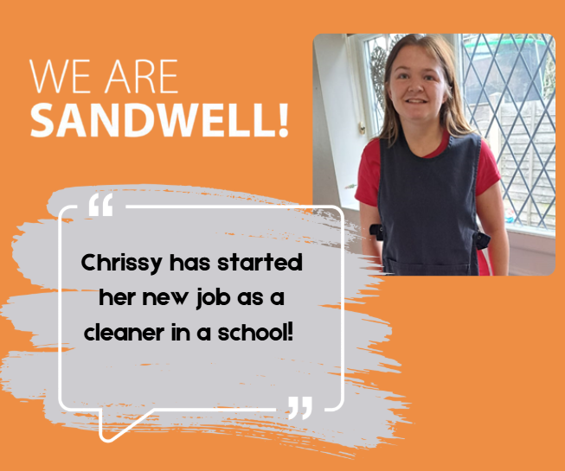

Case study: Chrissy starts work
May 2023
Chrissy has started her new job as a cleaner in a school!
Chrissy is in a long-term, transitional Shared Lives placement. With support from the Shared Lives scheme guiding her in the direction of the Sandwell’s Specialist Employment Team, and her Shared Lives Carer, Julie, advocating on Chrissy’s behalf for reasonable adjustments and support – Chrissy bagged herself the job she set out for.
She enjoys cleaning and keeping things tidy, so she is perfect for her new role!

Slide 2
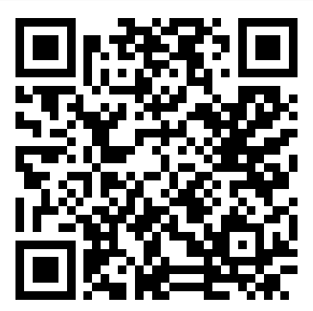

Case study: Chrissy starts work
May 2023
Chrissy is already a valued member of her team, going above and beyond to get the job done. Go Chrissie!
Find out more
www.sandwell.gov.uk/disability/shared-lives-scheme

