Slide 1

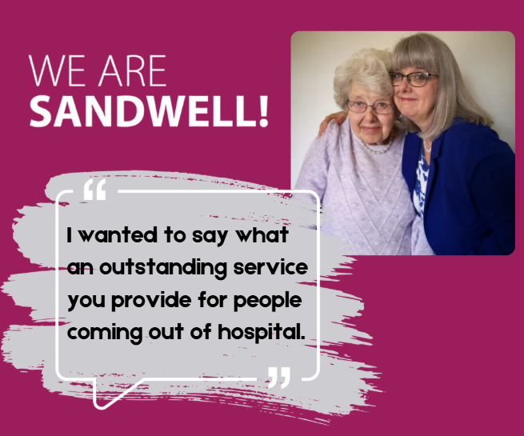

Case study: A thank you from Julie
October 2023
Our STAR (Short Term Assessment and Reablement) service is provided in people’s own homes to improve daily living skills and enable individuals to live independently again.
Here’s some fantastic feedback from Julie Beard about her mom’s experience of using the service following a hospital stay:
Julie said:
“I wanted to say what an outstanding service you provide for people coming out of hospital to help them gain their independence and live in their own homes once again. This recently happened to our family when my mom was hospitalised. We were so impressed by the carers who attended, they were lovely.

Slide 2
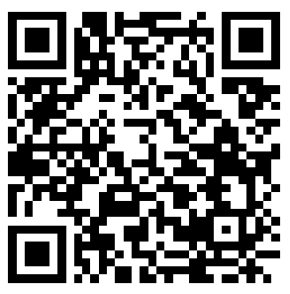
Case study: A thank you from Julie
October 2023
A big shout out to Karen, Tina, Chloe, Chelsey, and Sarah who were always helpful, kind attentive and kept us in the loop if there were any issues. Also a big thank you to the people on the STAR phone line who were always available to speak with us and keep on top of visits and medication.
Kerry was a great help in trying to help us move forward to organise a new care package for mom and Malcolm went above and beyond on a Saturday morning when we had an issue with medication that had been prescribed by mom’s GP. Thank you so much.”
For more information about our STAR service visit: www.sandwell.gov.uk/carers/support-home-need

