Slide 1
Grant Management Guide
Grantee Common Login Issues & Tips in Oracle Fusion

Slide 2
Who is this guide for?
This guide contains tips for common issues that you may encounter as a grantee organisation when using the Sandwell Grant Management System.
Using the ‘Access the application’ link in the notification that you receive when Contact User Account is created
The link in the email ‘Activate your profile in account – sandwellmbc’ has expired
Pop-up box requesting you to sign in to access the site
Please note below the link to access the GMS application. We suggest bookmarking this or adding to your favourites for easy access
https://idcs-26438ae380b347ed8819507e50f281aa.identity.oraclecloud.com/ui/v1/myconsole
Please email admin_VSGT@sandwell.gov.uk for any queries.

Slide 3
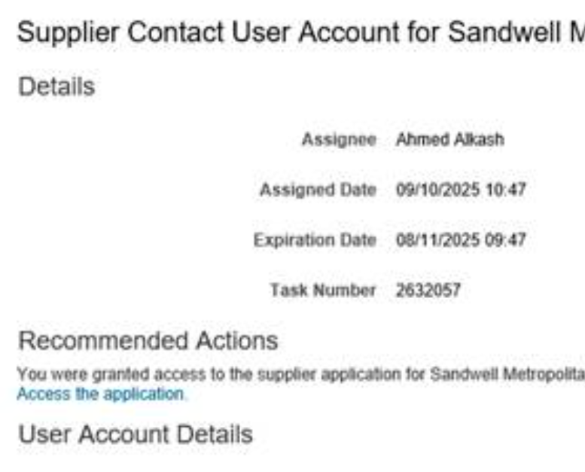
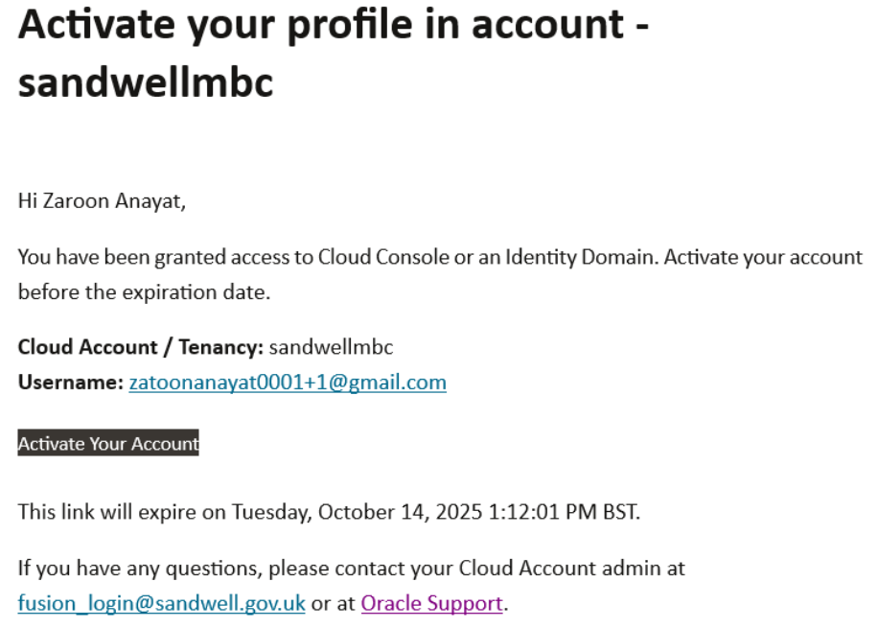
Do not use the ‘Access the Application’ link in the notification that you receive when the Contact User Account is created
Instead wait for the email to Activate your profile which is sent shortly after 1 pm and 7 pm

Slide 4
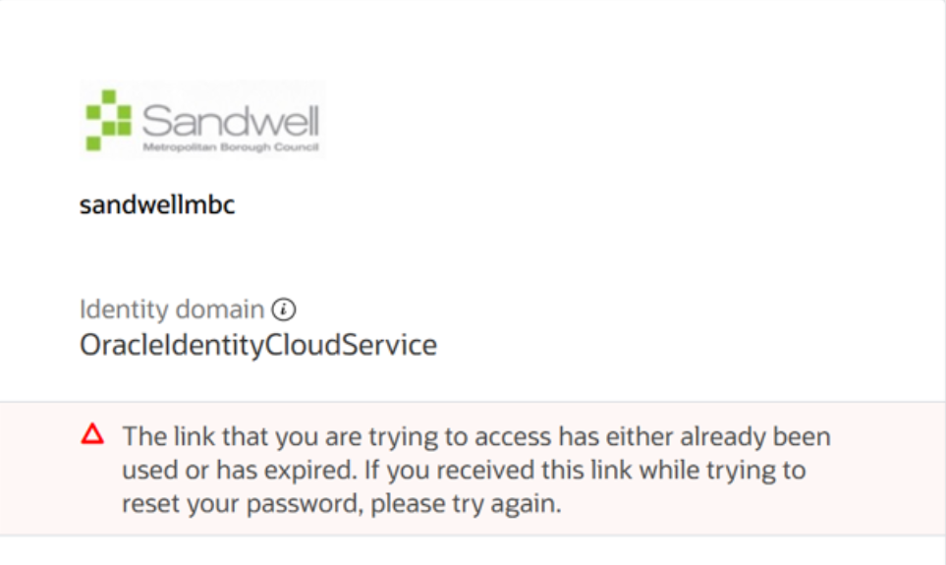
The link in the email ‘Activate your profile in account – sandwellmbc’ expires after 24 hours and you will get the message below. Please refer to Part 2 of the document ‘QRG_Logging_into_Fusion_Personal_Email_Address_User_Oct24_v1_Final (1)’ to reset your password

Slide 5
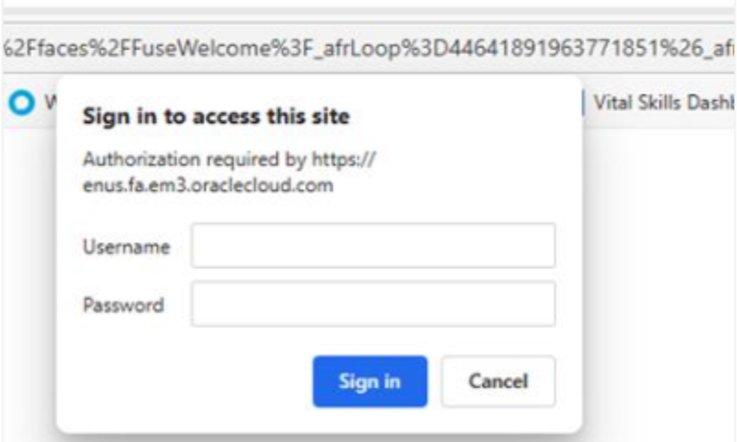
If you receive a pop-up box asking for the Username and Password then click on the Cancel button. If this doesn’t resolve the issue then this means you may have entered an incorrect password too many times and your account is locked. You will need to reach out to admin_VSGT@sandwell.gov.uk to get your account unlocked.

Slide 6
Thank You

