Slide 1

ANNUAL COMPLAINTS REPORT
2024/2025

Slide 2

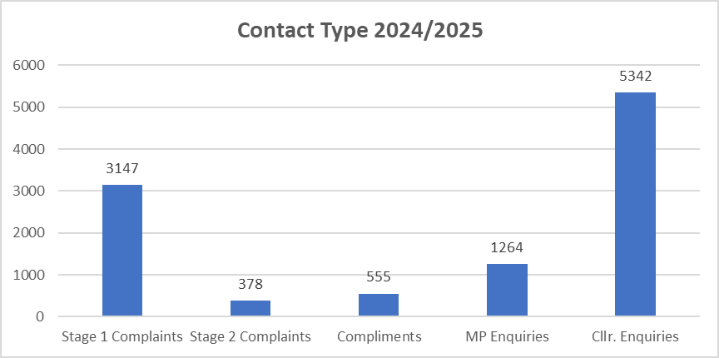
HEADLINE FINDINGS
1,436,475 total public interactions with the Council across all channels in 24/25
10,686 cases of feedback received in 24/25
Feedback received on less than 1% of all interactions
The strikingly low percentage of interactions resulting in feedback underscores that most of our interactions with residents are handled effectively and without the need for formal complaints or feedback, reflecting a strong overall performance in service delivery.

Slide 3



PERFORMANCE COMPARISON
In the 2024/25 financial year, 65% of all complaints received by the Council were responded to within the target timeframes set by their Service Level Agreements (SLAs)
While this represents a slight decline from the previous year, when 69% of complaints met the SLA and the average response time was 15 working days, it highlights the ongoing need for a much more focused effort by all service area to meet the SLA target.
Stage 2 complaints: 51% met the 20-day SLA, with an average response time of 25 working days.
Stage 1 complaints: 66% were resolved within the 10-day SLA, with an average response time of 15 working days.
The overall average response time was 16 working days.

Slide 4

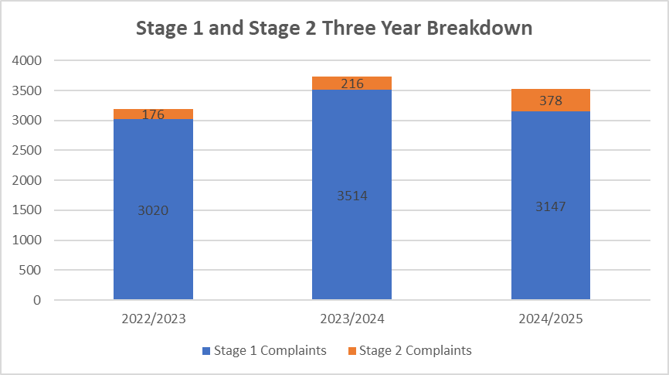
COMPLAINTS
Stage 1 and Stage 2 complaints compared with data from the previous two years.
Over the past 12 months, we have seen a positive reduction in the proportion of complaints upheld following investigation. At Stage 1, 518 complaints (16%) were upheld, while at Stage 2, 72 complaints (19%) were upheld. This marks a notable improvement compared to the previous year, where 23% of complaints were upheld overall. These figures reflect the positive impact of our ongoing efforts to improve service delivery and decision-making across the Council.

Slide 5

Performance Against Complaint Response SLAs
An overview of performance across Directorates in meeting complaint response times (SLA compliance) shows varying levels of success, with several standout performers and areas requiring attention.
  FINANCE & TRANSFORMATION
  REGENERATION % GROWTH
  ASSISTANT CHIEF EXECUTIVE
  HOUSING
  ENVIRONMENT
44% SLA COMPLIANCE
84% SLA COMPLIANCE
84% SLA COMPLIANCE
96% SLA COMPLIANCE
95% SLA COMPLIANCE
1506 COMPLAINTS
52 COMPLAINTS
407 COMPLAINTS
52 COMPLAINTS
65 COMPLAINTS
Housing Resolutions received the highest number of complaints (763), but only 25% were responded to within the SLA timeframe, highlighting a key area for improvement.
Homes & Communities, while handling a smaller volume of complaints (26), achieved strong performance with 96% of responses meeting the SLA.
Borough Economy delivered a solid performance, especially considering complaint volume with a total of 1,494
The Council Tax Billing service area received the most complaints (159) and performed on par with the Directorate average, also achieving 84% SLA compliance.
Refuse and Recycling, which generated the highest number of complaints in this Directorate (863), maintained a commendable 87% SLA compliance rate.
Though complaint volumes were comparatively low, the Customer Contact Centre stood out, handling 54 complaints with an impressive 96% SLA compliance rate.

Slide 6

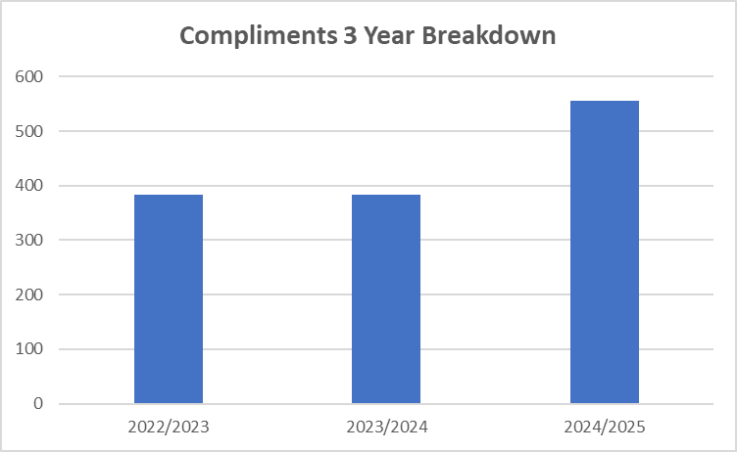
COMPLIMENTS
This Chart details the number of all compliments received by Sandwell Council in 2024/25 and compares these numbers with the data from the previous two years.
45% increase in compliments in 2024/25
Notes:
Place people and ace top 3

Slide 7
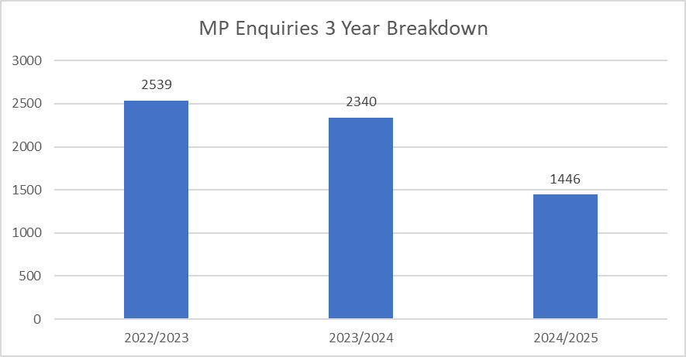
MP ENQUIRIES
This Chart details the number of all MP enquiries received by Sandwell Council in 2024/25 and compares these numbers with the data from the previous two years:
62% decrease
In 2024/25, the average response time for MP enquiries increased to 16 working days, compared to 10 working days in the previous year, despite a notable reduction in the total number of enquiries (1,446 in 2024/25 compared to 2,340 in 2023/24).
This can largely be attributed to the July 2024 General Election, which resulted in four new MPs. As a result, time was required to establish working relationships and ensure new MPs, and their teams were fully briefed on local processes and ongoing issues.
Notes:
Housing highways and asc top 3

Slide 8


OMBUDSMAN
The Customer Feedback Team (CFT) acts as the Ombudsman Link Officer for both the Housing Ombudsman (HO) and the Local Government and Social Care Ombudsman (LGSCO). These bodies play a critical role in overseeing complaints and ensuring accountability across housing and local authority services.
The Housing Ombudsman investigates complaints related to social housing providers, including issues such as repairs, tenancy management, and complaint handling.
In contrast, the LGSCO deals with complaints about wider local authority services, including housing allocations, homelessness support, and adult social care.
As a local authority, we are responsible for managing and responding to complaints in accordance with the frameworks set by both Ombudsmen. This ensures residents have access to fair, transparent, and effective complaint resolution processes. Both organisations provide independent oversight and contribute to service improvement by identifying systemic issues and sharing best practices.

Slide 9
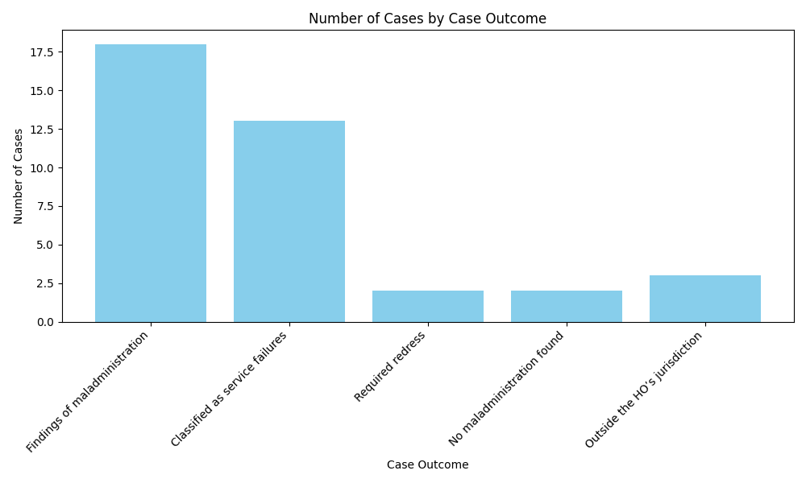

HOUSING OMBUDSMAN DATA
Between 1 April 2024 and 31 March 2025, the Housing Ombudsman (HO) handled 38 cases relating to Sandwell Council. Of these, all 38 were enquiries, and 35 progressed to full investigations, an increase from 29 investigations in 2023/24.
Notes:
In terms of financial impact, the Housing Ombudsman awarded a total of £11,270 in compensation during the year, including £8,020 in formal orders and £3,250 in recommendations. This represents a significant increase from the previous year’s total of £2,128. A major contributor to this rise was complaints related to property conditions.

Slide 10
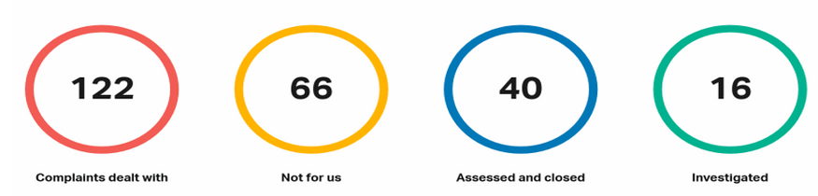
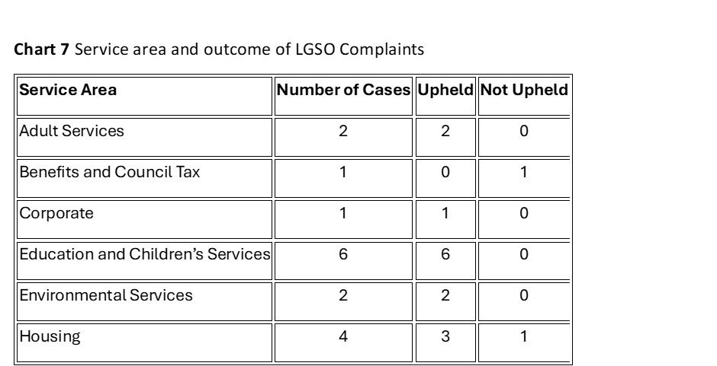
LOCAL GOVERNMENT AND SOCIAL CARE OMBUDSMAN DATA
Between 1 April 2024 to 31 March 2025, the LGSCO dealt with 122 Sandwell Council complaints. Of these, 66 were not for them or were not ready for them to investigate. The LGSCO assessed and closed 40 complaints. They fully investigated 16 complaints.
  16 full investigations
  14 upheld
  4 upheld decisions per 100,000 residents
  100% compliance rate
Notes:
Total amount paid by LGSCO £24,710

Slide 11

In 2024/25, over 50 officers involved in handling corporate complaints successfully completed the Local Government and Social Care Ombudsman’s (LGSCO) official complaints training.
This directly responds to previous feedback noting that the Council had not made use of this training in recent years.
Due to the positive impact of the sessions, the Customer Feedback Team will continue to offer further training opportunities.
In recognition of national trends and areas of concern, the Ombudsman has now introduced specialised training sessions focused on Adult Services and Education complaints—two areas consistently highlighted across regions as needing additional support.
These new sessions aim to strengthen officers’ skills and ensure a more consistent and effective approach to complaint handling.
The Customer Feedback Team has delivered bespoke training sessions to all service areas involved in LGSCO cases. These sessions introduced the forthcoming LGSCO Complaint Handling Code (becoming statutory in April 2026) and clarified the roles of both the LGSCO and Housing Ombudsman, particularly in cross-jurisdiction cases.

Slide 12




LESSONS LEARNED
The Council remains committed to learning from complaints and will continue to strengthen its approach to Ombudsman engagement, training, and case management going forward.
Sandwell Council recognises the importance of learning from complaints as a key element of service improvement. Complaints provide an opportunity to identify weaknesses in our processes and service delivery, and CFT are committed to using this feedback constructively.
In line with the Complaint Handling Codes issued by both the HO and the LGSCO, we take a systematic approach to reviewing complaint outcomes. This includes identifying learning points, implementing corrective actions, and monitoring progress to ensure improvements are sustained. We ensure that any lessons learned from complaints are shared across the relevant teams and services, contributing to a culture of accountability, continuous improvement, and better outcomes for residents.
Examples of lessons learned from various Council directorates during the reporting period are outlined in the (Appendix 3 - Lessons Learnt 2024-25)

Slide 13
Recommendations for actions to be taken in response to any issues/concerns raised.
1
2
3
4
5
To replace the current systems used for logging and managing customer feedback (DASH and Open Housing) with a single, easy-to-use, streamlined solution
Stage 1 and Stage 2 complaints will be treated as a priority and responded to within the required timeframes - increase SLT ownership
Learning from Positive Feedback
Recognising and learning from compliments is an important part of continuous improvement, helping to build on strengths and an opportunity to share good practice.
Ensure good communication through timely acknowledgement of complaints with responses that demonstrate empathy, use an appropriate tone, and are person-centred
All Directorates are responsible for capturing and applying lessons learned, helping to embed a culture of continuous improvement across the organisation.
6
7
8
9
10
Service Areas Refresher Training Sessions to include Ombudsman guidance
Continued monitoring and targeted MP Training sessions
Coordinated approach to compliance with LGSCO Complaint Handling Code embedded through guidance, training and oversight
Local Government and Social Ombudsman (LGSO) - Strengthening Ombudsman Engagement and Service Accountability
Dedicated Accounts on MySandwell for MP Enquiries and batter use of portal

