Slide 1

Sandwell Domestic Abuse Strategy
2025 - 2028

Slide 2

Foreword
Domestic abuse steals safety, hope, and dignity from too many lives in Sandwell.
We cannot and will not stand by.
This Strategy is more than a plan — it is a promise.
A promise that we will listen to survivors.
A promise that we will act together.
A promise that we will build services, systems, and communities where abuse is never ignored, survivors are never alone, and perpetrators are held to account.
Informed by lived experience, local evidence, and the expertise of our partnerships, this Strategy lays out a clear, coordinated approach to strengthen prevention, enhance protection, and promote lasting recovery.
Together, we will work for a Sandwell where freedom from abuse is not the exception — it is the norm.
Councillor Suzanne Hartwell, Deputy Leader and Cabinet Member for Neighbourhoods and Community

Slide 3
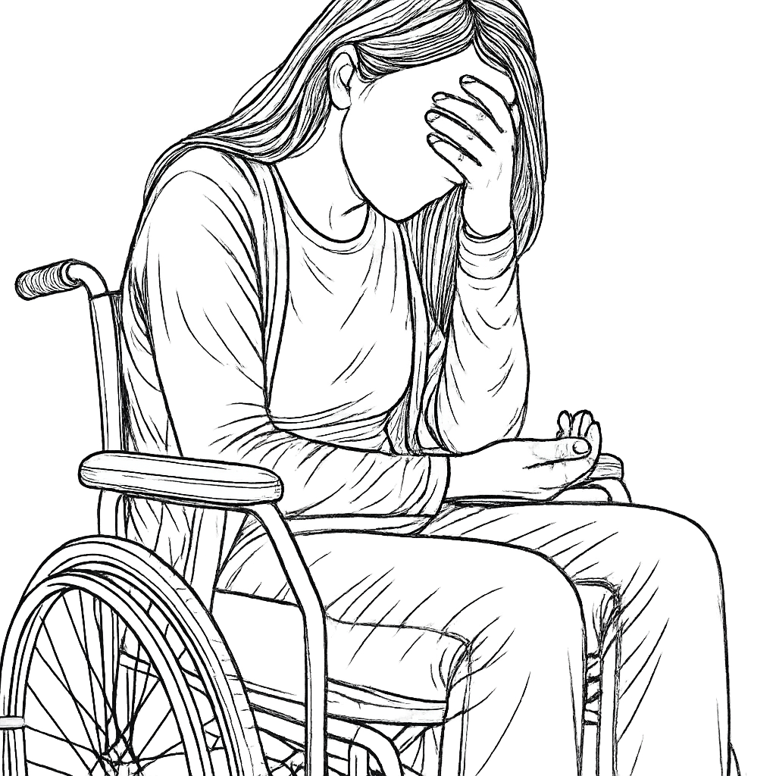
Vision
In Sandwell, domestic abuse is not tolerated.
Every resident, regardless of background or identity, can live safely, freely, and without fear.
We will build a community where survivors are supported, perpetrators are held accountable, and prevention is embedded into everyday life.
3

Slide 4
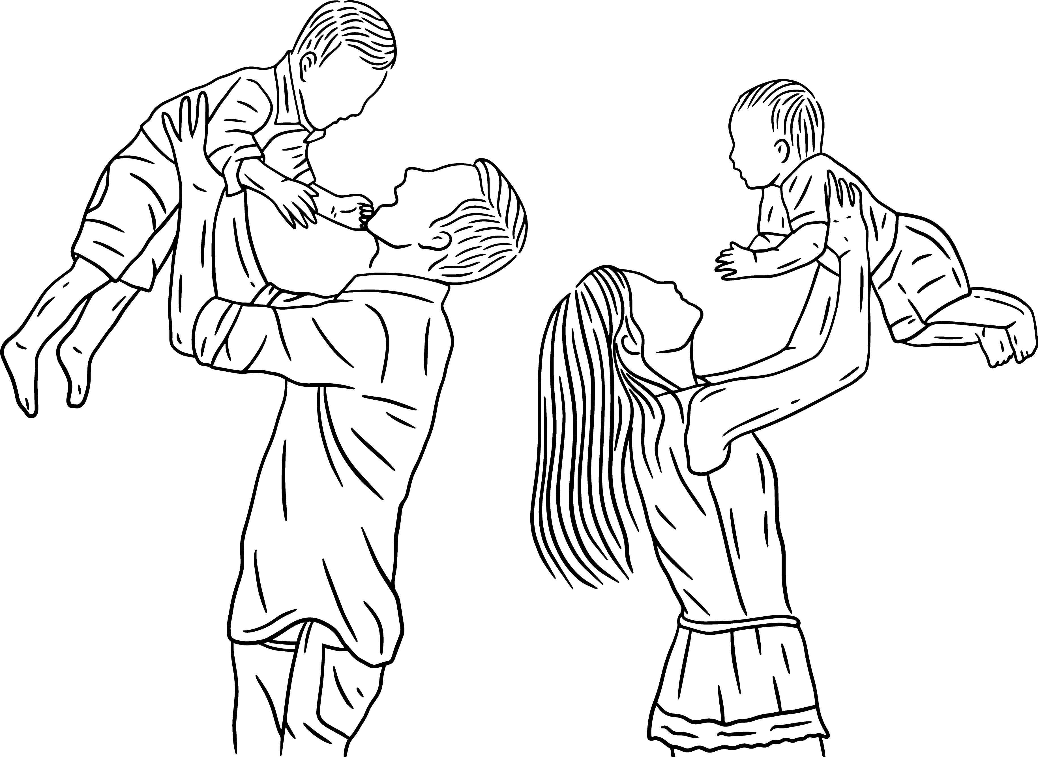
As partners in Sandwell, we are united in our commitment to tackle domestic abuse and build a safer, stronger borough.
We pledge
To work together effectively to ensure that all forms of abuse, including domestic abuse and sexual assault and abuse, will not be tolerated in Sandwell.
That everyone, regardless of their race, religion or beliefs, gender, disability or sexual orientation, can expect equality and respect in their relationships and interactions with agencies.
To work in partnership with victims and survivors to ensure their voices are heard, and that they and their families are supported by a coordinated community response.
That domestic abuse perpetrators subject to statutory disposals complete interventions to address their behaviour and that protective controls are in place for victims.
That communities are actively engaged, building on their strengths to prevent abuse and create long-term solutions.
We
pledge
4

Slide 5

Domestic Abuse Strategy 2025
This Domestic Abuse Strategy for Sandwell 2025–2028 sets out a shared, system-wide commitment to tackling domestic abuse across our borough. It represents the collective response of all partner agencies to the findings of the recent Domestic Abuse Needs Assessment.
Grounded in robust evidence, the voices of victims and survivors, and the priorities agreed through extensive consultation, this Strategy is co-owned by the organisations, services and communities that form Sandwell’s multi-agency response.
Structured around five key pillars, it sets out a coordinated, survivor-centred approach to prevention, protection, provision, partnership working, and system accountability. Each partner plays a vital role in delivering this ambition.
Our vision is clear: to build a Sandwell where abuse is never ignored, survivors are protected and supported, perpetrators are held to account, and communities are equipped to prevent harm and promote recovery.
This strategy contributes directly to Sandwell’s duties under the Serious Violence Duty, recognising domestic abuse as both a form and a driver of serious violence. Cross-strategy alignment with our Knife Crime and Serious Violence Strategies ensures a joined-up response to reducing harm across the life course.
Domestic abuse is a significant and complex issue in Sandwell, with deep and lasting impacts on individuals, families, and communities.
Tackling domestic abuse is a strategic and moral priority for Sandwell Council and its partners. Our commitment is rooted in a shared vision that every resident should be able to live safely, freely, and without fear.
This strategy is shaped by a strong evidence base, national and local learning, and the voices of those with lived experience. It provides the framework for a coordinated, survivor-centred response — strengthening protection, enhancing prevention, improving provision, and pursuing perpetrators.
Together, we will work towards lasting change for individuals, families, and communities across Sandwell
5

Slide 6

Purpose
Scope
This strategy sets out Sandwell’s borough-wide approach to preventing, responding to, and reducing domestic abuse. It aims to provide a clear, coordinated direction for all partners, ensuring that survivors are supported, perpetrators are challenged, and communities are empowered.
This Strategy covers all forms of domestic abuse — physical, emotional, psychological, sexual, economic, and coercive control — across all age groups, genders, and communities.
It applies across Sandwell’s whole system: statutory agencies, commissioned services, the voluntary sector, and community organisations.
It has been shaped through a detailed Domestic Abuse Needs Assessment, survivor consultation, service mapping, and multi-agency input. Survivor voices are at the heart of its development.
The Strategy focuses on five key pillars:
1. Strengthening Safeguarding and Partnership Working;
2. Enhancing Safe Accommodation and Housing Pathways;
3. Strengthening Early Intervention and Support for Children and Young People;
4. Improving Cultural Competency and Step-Down Community Support;
5. Embedding Stronger Monitoring, System Learning, and Accountability.
It aims to:
Prevent abuse through early intervention and community engagement.
Support victims and survivors towards lasting recovery.
Hold perpetrators to account.
Strengthen system-wide collaboration and resilience.
6

Slide 7
Introduction
Key developments influencing this Strategy include:
The new statutory definition of domestic abuse, encompassing physical, emotional, economic, and coercive behaviours between personally connected individuals.
The statutory duty on local authorities to commission support services for victims in safe accommodation settings, supported by Domestic Abuse Safe Accommodation funding.
National commitments to strengthen policing, with the inclusion of violence against women and girls within the Strategic Policing Requirement, and the development of new tools such as Domestic Abuse Protection Orders (DAPOs).
The publication of the national Violence Against Women and Girls Strategy, with ambitions to prioritise prevention, pursue perpetrators, support victims, and strengthen the system.
The Domestic Abuse Act 2021 remains the cornerstone of national policy and practice around domestic abuse, setting the legal framework that underpins this Strategy.
The Act broadened the statutory definition of domestic abuse, recognising not only physical violence but also coercive control, emotional and financial abuse, and the profound impact on children living in abusive environments. It established clear responsibilities for local authorities, including Sandwell Council, to provide specialist support within safe accommodation and to strengthen the system-wide response to domestic abuse.
This new Strategy builds on that foundation — integrating national duties, local evidence, and survivor voices — to create a coordinated, survivor-centred, and future-ready response to domestic abuse in Sandwell.
Locally, Sandwell has responded to these developments by:
Establishing and strengthening the Domestic Abuse Strategic Partnership (DASP) to oversee strategic leadership.
Creating a Domestic Abuse Forum to bring together community voices, specialist services, education settings, and wider stakeholders.
Embedding a victim voice approach through the recruitment of a Victim Voice Coordinator and plans to develop a Victim Advisory Panel.
Delivering against the 2021 Domestic Abuse Strategy through an implementation plan aligned to the 4P model: Protect, Prevent, Pursue, and Prepare.

Slide 8
Our Strategic Focus
Strategic Pillars
This Strategy sets out Sandwell’s collective commitment to ending domestic abuse by building a stronger, survivor-centred system. Our future work is anchored in five strategic pillars, each designed to strengthen prevention, protection, provision, partnership working, and system accountability.
The pillars reflect the priorities identified through consultation with survivors, professionals, partners, and communities, alongside evidence from national and local data.
By working together across these areas, we will drive forward lasting change:
Survivors are safer and better supported.
Communities are empowered to break the cycle of abuse.
Perpetrators are challenged and held to account.
Our system is more coordinated, inclusive, and resilient.
Each pillar plays a vital role in creating a Sandwell where freedom from domestic abuse is the norm — not the exception.
Our response prioritises equity, with targeted approaches for communities at higher risk of hidden or compounding harm — including those with insecure immigration status, disabilities, and marginalised identities.
1
Strengthening Safeguarding and Partnership Working
Enhancing identification, triage, and frontline responses through stronger multi-agency collaboration.
2
Enhancing Safe Accommodation and Housing Pathways
Securing recovery through high-quality safe accommodation, strengthened resettlement support, and sustainable move-on solutions.
3
Strengthening Early Intervention and Support for Children and Young People
Expanding support pathways through Family Hubs, schools, and specialist provision to protect and empower children impacted by domestic abuse.
4
Improving Cultural Competency and Step-Down Community Support
Building a more inclusive, culturally responsive system, and empowering survivors through peer networks and community engagement.
5
Embedding Stronger Monitoring, System Learning, and Accountability
Using evidence, data, and survivor voice to drive continuous improvement, measure progress, and hold all partners to account.
8

Slide 9

Current Position
Specialist Domestic Abuse Support
Commissioned provider: Black Country Women’s Aid (BCWA).
Emergency safe accommodation available to victims with or without children, regardless of age, gender, disability, ethnicity, or sexuality.
Specialist male victim support through Ask Marc.
Therapeutic and Emotional Support
1:1 counselling and mindfulness sessions for women and children.
Art therapy and joint parent-child therapeutic sessions.
Therapeutic support extended into resettlement periods.
Housing and Resettlement Support
Dedicated part-time Resettlement Worker assisting with direct offer fast-tracking and post-move support (up to 3 months).
Strengthened pathways between DA services and Sandwell Housing.
Support for Children and Families
Two Family Support Workers offering advice, guidance, signposting, and direct support to children.
Attendance at Child Protection Conferences and provision of 1:1 child-focused interventions.
Community-Based Services
Emotional support, court support, practical security improvements for properties.
Signposting and access to wider specialist services.
Sandwell has made significant progress in strengthening the local response to domestic abuse, ensuring a more coordinated, survivor-centred system.
Our commissioned services provide a wide range of specialist support that is accessible, inclusive, and responsive to the diverse needs of our community.

Slide 10

1. Strengthening Safeguarding and Partnership Working
Inconsistent frontline responses to domestic abuse — some victims experienced victim-blaming and poor cultural sensitivity.
MARAC referrals far exceed SafeLives benchmarks, but IDVA capacity is below recommended levels.
Adult safeguarding cases involving domestic abuse are under-identified, particularly when abuse is from family members.
The need for a stronger triage model to improve safety planning and learning.
2. Enhancing Safe Accommodation and Housing Pathways
Secure commissioning of safe accommodation until 2028 through BCWA, with expanded capacity for diverse needs.
High-quality therapeutic and resettlement support highly valued by victims.
Challenges in move-on housing due to lack of local stock, causing longer stays.
No specialist domestic abuse support available for lower-risk victims in temporary accommodation.
3. Strengthening Early Intervention and Support for Children and Young People
Increasing cases of direct abuse of children as well as witnessing domestic abuse.
Family Hubs emerging as key settings for early identification and support.
Gaps in specialist support for children not already linked to BCWA services.
Stronger IDVA presence in MASH supporting safeguarding interventions.
4. Improving Cultural Competency and Step-Down Community Support
Sandwell has strong representation across ethnic groups within services, showing broad accessibility across communities.
Survivors voiced a clear interest in staying connected, with many wanting to offer support to others once their formal help ends.
Community and culturally specific groups could play a greater role, if trained and supported to safely identify abuse and refer into specialist services.
5. Embedding Stronger Monitoring, System Learning, and Accountability
Stalking, coercive control, and financial abuse cases are rising.
Gaps in consistent data collection across health and housing services.
Variation in service access and outcomes suggests the need for stronger, shared learning frameworks.
Need for improved system-wide monitoring of temporary accommodation support for domestic abuse victims
Key Findings
from the
Needs Assessment
The following key findings, grouped under our five strategic pillars, shape the priorities for action over the next three years
10

Slide 11

Pillar 1
Strengthening Safeguarding and Partnership Working.

Slide 12
Pillar 1:
Strengthening Safeguarding and Partnership Working
The outcomes we want to deliver
Survivors are identified early, protected quickly, and supported throughout their journey.
Safeguarding responses are timely, consistent, and culturally sensitive.
Perpetrators are identified, managed, and disrupted through coordinated action.
Agencies understand and fulfil their safeguarding responsibilities with confidence.
System gaps are closed through shared learning and partnership accountability.
What the evidence tells us
MARAC demand is rising, with referral volumes far exceeding expected levels based on population benchmarks.
Current IDVA capacity is below SafeLives guidance, creating pressure on case management and limiting timely support.
Adult child-to-parent violence and stalking are increasing, with Sandwell reporting the highest levels of both in the region.
There are inconsistencies in front-line responses, including missed opportunities for disclosure, cultural insensitivity, and victim-blaming.
Individuals with additional care and support needs are more vulnerable to the risk and hidden harm of domestic abuse.
Sandwell has seen an increase of domestic abuse related deaths by suicide, which coincides with an improved awareness and response from partners.
What we will do
Develop and embed a MARAC triage model across partners to improve risk assessment, prioritisation, and safeguarding outcomes.
Work together to increase IDVA capacity, ensuring provision aligns with SafeLives guidance and reflects local demand.
Improve identification and referral pathways from all frontline services — including Adult Social Care, Housing, and Health.
Ensure learning from Domestic Abuse Related Death Reviews are embedded throughout the partnership
Provide joint training for all first responders, focused on trauma-informed practice, cultural competency, and early intervention.
What we want to deliver
We want all victims and survivors of domestic abuse in Sandwell to feel protected and supported at every point of their journey — whether at disclosure, safeguarding, intervention or long-term recovery.
We aim to create a coordinated and survivor-centred system where agencies work together to proactively identify, assess, and reduce harm.
How will we know we’re on track
Reduction in repeat MARAC cases.
Increase in safeguarding referrals where domestic abuse is appropriately flagged.
Improved victim satisfaction ratings from service feedback.
Increased referrals into specialist services from health and housing.
12

Slide 13

Pillar 2
Enhancing Safe Accommodation and Housing Pathways

Slide 14
Enhancing Safe Accommodation and
Housing Pathways
The outcomes we want to deliver
Victims are supported to access safe accommodation without delay or barriers.
Housing pathways are trauma-informed and responsive to individual needs.
Victims in temporary accommodation are linked into specialist support.
Resettlement services help reduce isolation and support long-term recovery.
What the evidence tells us
Safe accommodation commissioned to 2028
Victims highly value the therapeutic, resettlement and wraparound support provided in safe accommodation.
Challenges exist in moving on from safe accommodation due to severe lack of local housing stock.
Low referral rates from health and mental health services into safe accommodation pathways.
Lack of specialist domestic abuse support currently available for lower-risk victims in temporary accommodation settings.
What we will do
Maintain and monitor delivery of the commissioned safe accommodation services, ensuring high standards are met.
Expand therapeutic and resettlement support to help victims prepare for independence.
Work with Housing Services to prioritise move-on solutions for victims leaving safe accommodation.
Work with partners to identify move-on solutions, explore reciprocal housing agreements, and reduce delays caused by limited housing stock.
Progress re-accreditation under the Domestic Abuse Housing Alliance (DAHA) framework to improve housing sector response.
What we want to deliver
How will we know we’re on track
We want all victims of domestic abuse in Sandwell to have access to safe, appropriate accommodation that supports their recovery, dignity, and long-term stability.
We aim to deliver a housing and resettlement system that is trauma-informed, inclusive, and fully integrated with wider domestic abuse and safeguarding pathways.
Consistent occupancy rates across all safe accommodation units.
Reduction in average length of stay in safe accommodation due to improved move-on.
Victim feedback evidences satisfaction with resettlement support.
DAHA re-accreditation successfully achieved.
14

Slide 15

Pillar 3
Strengthening Early Intervention and Support for Children and Young People

Slide 16

Strengthening Early Intervention and Support for Children and Young People
The outcomes we want to deliver
Children are recognised as victims in their own right and receive support tailored to their needs.
Schools deliver effective, age-appropriate healthy relationship education.
Fewer children experience repeat or escalating harm linked to domestic abuse.
What the evidence tells us
What we will do
There is a rising number of cases where children are directly experiencing abuse, not just witnessing it.
Family Hubs are emerging as key places for earlier identification and community-based support.
Gaps exist in specialist support for children who are not already linked into support services.
Stakeholders and schools have raised concerns about inconsistent access to therapeutic and emotional support for children and young people.
The IDVA presence in the Multi-Agency Safeguarding Hub (MASH) is supporting stronger safeguarding interventions, but demand is increasing.
Strengthen early help pathways so that concerns about domestic abuse are identified and responded to at the earliest opportunity.
Continue the Flourishing Futures programme to reach more children, including those not already linked to BCWA services.
schools and education providers to embed consistent healthy relationships education across all year groups.
Embed a ‘Think Family’ approach across services to identify domestic abuse in family contexts.
Deliver workforce development across the partnership to improve confidence in recognising and responding to children's experiences of abuse.
How will we know we’re on track
What we want to deliver
Increase in early identification and referrals for children affected by domestic abuse.
All schools delivering consistent, quality-assured Healthy Relationships education.
Higher take-up of early help and Family Hub support by families experiencing domestic abuse
Increased access to specialist therapeutic support for children.
Positive feedback from children, young people, and families engaging with support services.
We want children and young people in Sandwell to be recognised, supported, and protected as victims of domestic abuse in their own right.
We aim to embed prevention and recovery across the system — enabling safe, stable relationships and breaking intergenerational cycles of abuse.
16

Slide 17

Pillar 4
Improving Cultural Competency and Step-Down Community Support

Slide 18
Improving Cultural Competency and
Step-Down Community Support
The outcomes we want to deliver
Increased trust, access, and engagement from underrepresented communities.
Community-based organisations are confident and equipped to identify domestic abuse and connect people to help.
Step-down and peer-led support options are available across Sandwell, helping survivors stay safe and recover long term.
What the evidence tells us
Referrals into specialist services reflect strong ethnic diversity, broadly aligned with Sandwell’s population.
Victims from a wide range of cultural and community backgrounds have shared positive experiences of support.
There is clear appetite across the community and voluntary sector to play a stronger role in identifying and responding to domestic abuse.
Survivors expressed interest in staying connected post-intervention, through peer support and survivor-led activities.
Developing a networked approach with trained community organisations would strengthen inclusion, awareness, and safe pathways into specialist help.
What we will do
Develop and deliver cultural competency training for all services working with domestic abuse victims and survivors.
Strengthen links with grassroots and faith-based organisations to build community capacity around early identification and support.
Pilot peer mentoring and survivor-led initiatives to support recovery and resilience.
Promote partnership-led messaging to challenge stigma, encourage disclosure, and increase awareness across diverse communities.
What we want to deliver
How will we know we’re on track
More grassroots organisations actively participating in the Domestic Abuse Forum.
Launch and evaluation of peer mentoring and survivor-led initiatives.
Positive feedback from diverse communities on the cultural relevance and accessibility of services.
Uptake of peer and step-down services grows, with clear evidence of survivor involvement in shaping delivery.
We want a system where every community in Sandwell feels included, understood, and empowered to respond to domestic abuse.
We aim to grow a culturally competent and community-driven network that supports survivors beyond immediate crisis intervention.

Slide 19

Pillar 5
Embedding Stronger Monitoring, System Learning, and Accountability

Slide 20
Embedding Stronger Monitoring, System Learning, and Accountability
The outcomes we want to deliver
All agencies use high-quality, consistent data to understand need and measure progress
Survivor feedback and lived experience shape services and drive improvements
Learning from reviews and audits is translated into real system change
There is clear accountability for outcomes at local and strategic levels
Sandwell becomes a leader in evidence-led, survivor-centred practice
What the evidence tells us
Domestic abuse data is often fragmented, inconsistent, or not fully utilised across agencies.
Survivors report frustration when they are not listened to or when feedback is not acted upon.
Key performance indicators are rarely aligned across housing, health, safeguarding, and criminal justice.
Learning from reviews, audits, and case feedback is not always systematically embedded.
Domestic abuse-related deaths are rising, with suicides now being recognised as part of the wider harm caused by prolonged abuse, often without adequate intervention or safeguarding.
What we will do
Create a multi-agency data dashboard that includes safeguarding, housing, justice, and health
Embed lived experience in evaluation, commissioning, and governance structures, reflective of all people at risk to further understand complexity of need
Produce an annual public report tracking progress, system learning, and areas for development
How will we know we’re on track
What we want to deliver
Increased use of joined-up data and reporting across agencies
Improved survivor satisfaction and evidence of service redesign based on feedback
Clear, published responses to learning from audits and reviews
Annual performance report shows improved outcomes and reduced disparities
Partners demonstrate shared ownership of learning and accountability
We want to embed a consistent, transparent, and data-driven approach to monitoring domestic abuse responses across Sandwell.
Every partner must be accountable for delivering timely, inclusive, and survivor-informed support — and we must learn continuously to improve what we do.
20

Slide 21
Our Five Strategic Pillars
Pillar | Focus | What We Will Achieve
1. Strengthening Safeguarding and Partnership Working | Improve safeguarding responses, enhance multi-agency collaboration, and close systemic gaps. | Survivors are protected and feel safe. Safeguarding is timely, proportionate, and culturally sensitive.
2. Enhancing Safe Accommodation and Housing Pathways | Expand access to high-quality, safe accommodation and improve move-on support. | Recovery is supported through sustainable housing solutions, and safe accommodation pathways are strengthened.
3. Strengthening Early Intervention and Support for Children and Young People | Identify and respond to domestic abuse earlier, focusing on children’s safety and wellbeing. | Children and young people are protected, empowered, and supported at the earliest opportunity.
4. Improving Cultural Competency and Step-Down Community Support | Build inclusive, survivor-led support networks and strengthen links with grassroots organisations. | Community resilience is strengthened, and survivors are empowered through culturally responsive support.
5. Embedding Stronger Monitoring, System Learning, and Accountability | Strengthen data, evidence, and shared learning across all agencies. | Continuous improvement and accountability drive better outcomes for survivors.

Slide 22
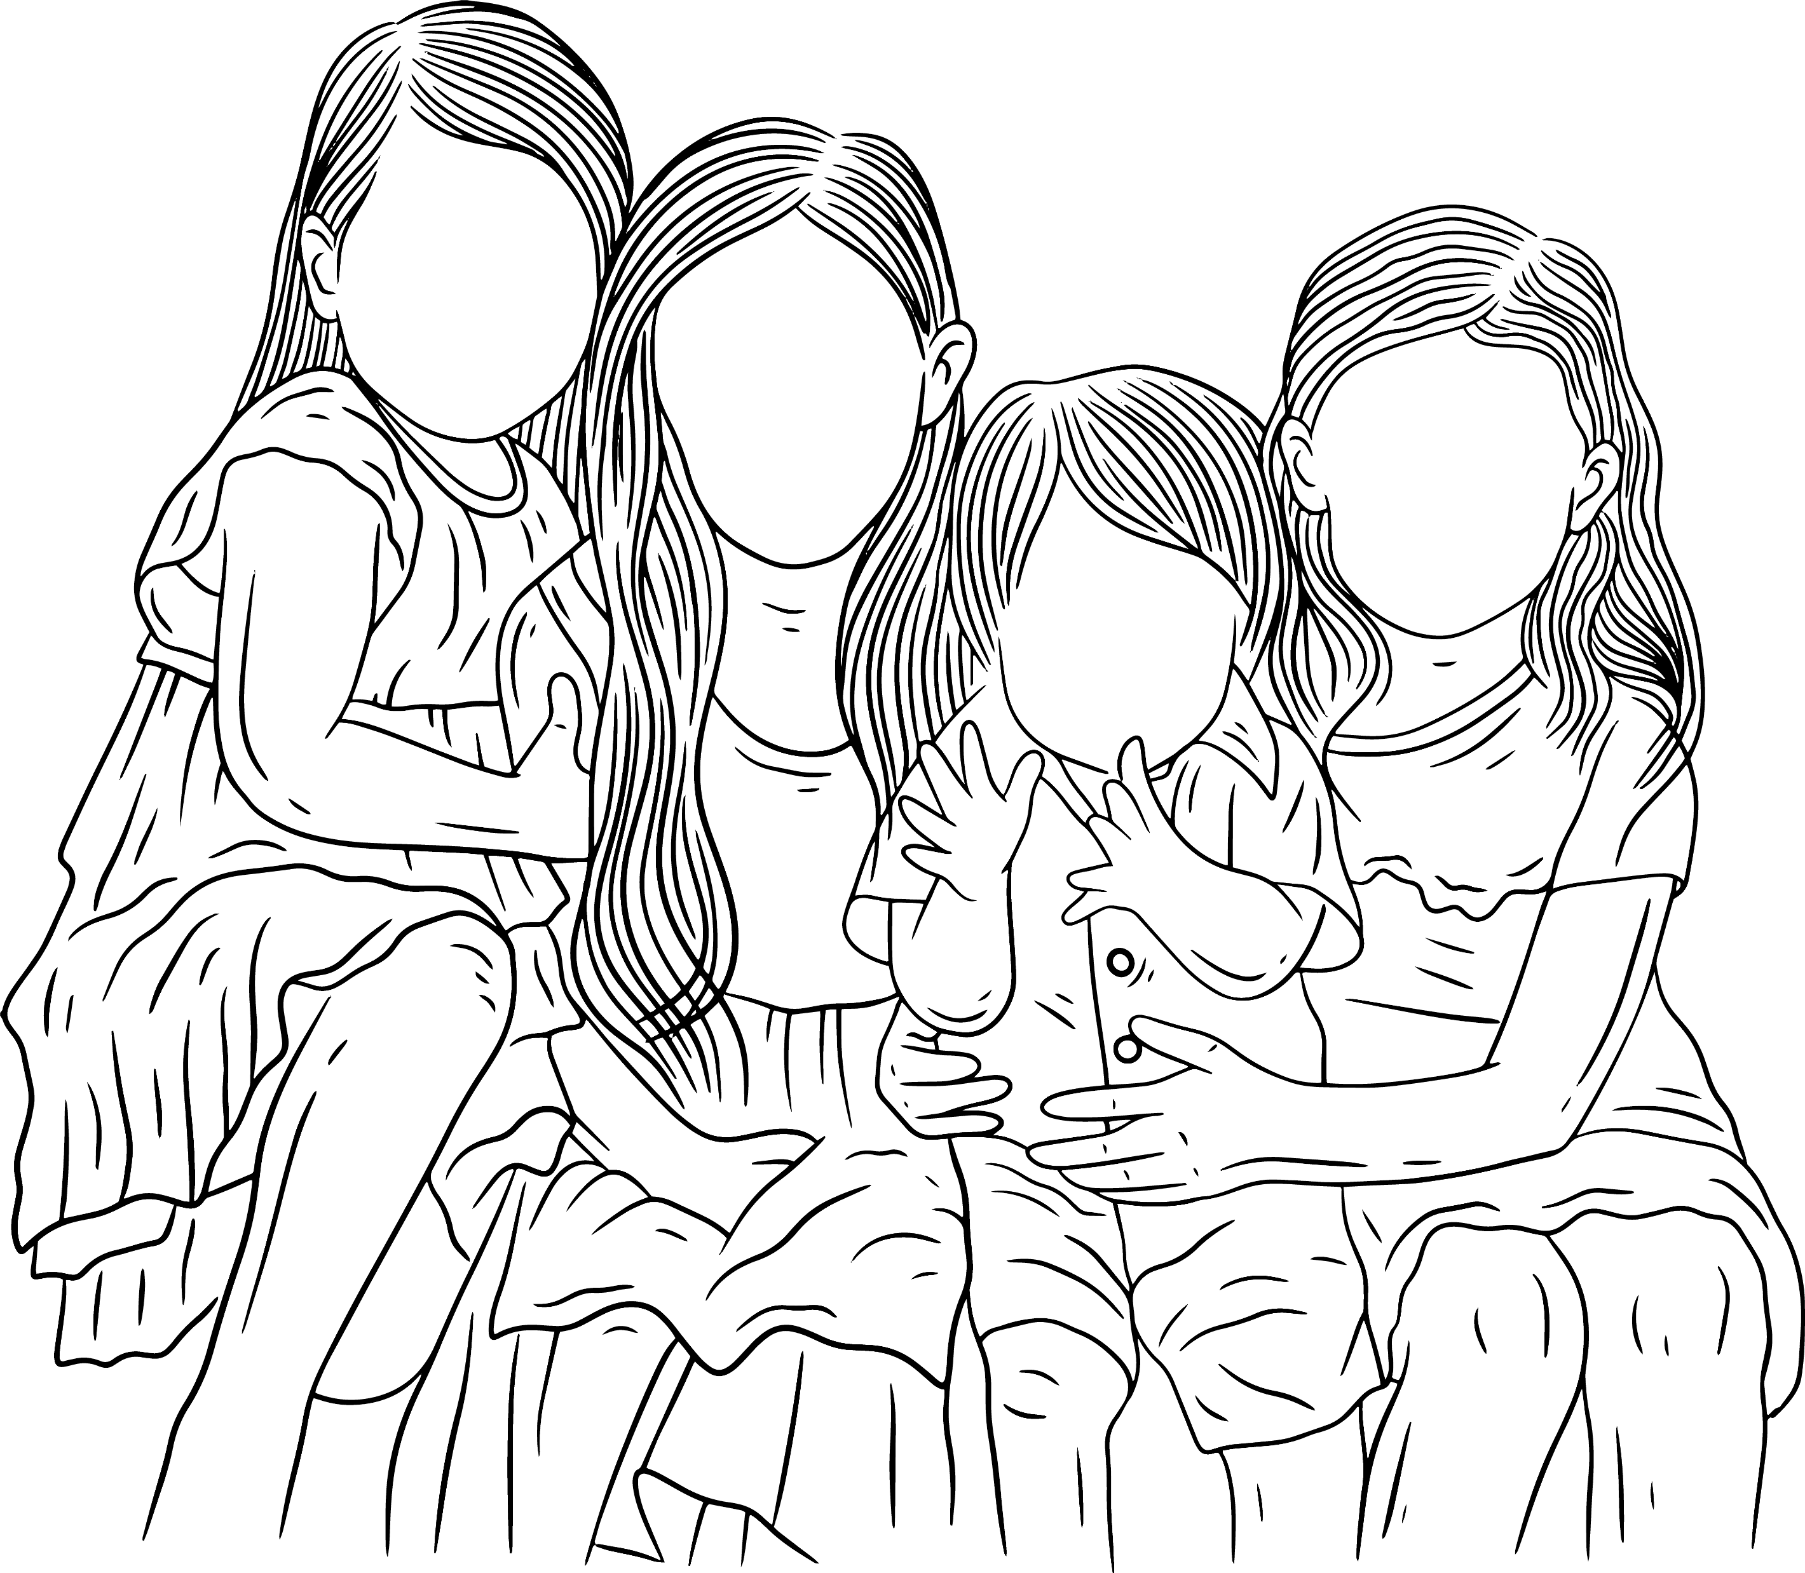
Conclusion
Delivering Together – A Shared Commitment for Sandwell
This Domestic Abuse Strategy reflects the collective commitment of all partners in Sandwell to tackle domestic abuse in all its forms. It is a partnership strategy — one that recognises every agency, service, and organisation has a role to play in building a coordinated, survivor-centred, and accountable system.
Through the voices of victims and survivors, the analysis of local data, and the insights of professionals, this strategy identifies the key changes needed to strengthen prevention, protection, provision, partnership working, and system accountability.
Together, we will deliver a stronger, more resilient response: one that holds perpetrators to account, supports survivor recovery, enables whole-family safety, and builds community capacity to break the cycle of abuse.
Sandwell is ready to lead with courage and collaboration. By acting on what we’ve learned — and staying committed to learning more — real and lasting change is not just possible, but within our grasp.
22

