Slide 1

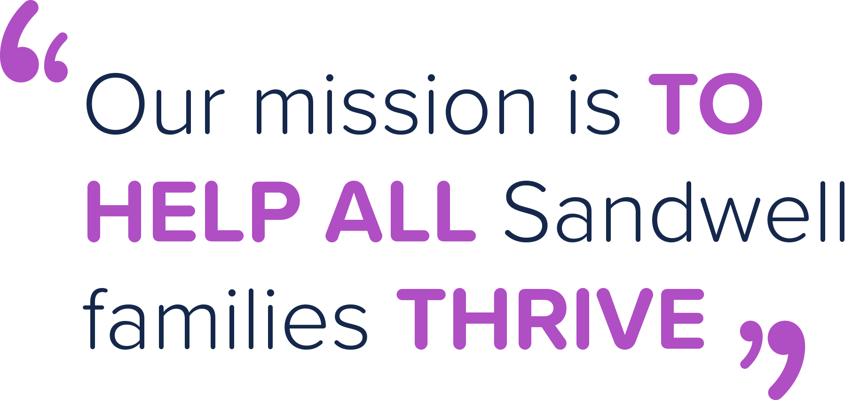



Welcome to
Sandwell Family Hubs

Slide 2

Family Hub Model
This is an overview of the proposed model for Family Hubs. There is sufficient information to agree:
The definitions for a Spoke and a network member
Agree the Family Hub model
To have one or two mobile spokes.
The route for the mobile spokes
The key areas for placement of spokes
The timeline for the rollout of the proposed model

Slide 3
Our aim for Hubs, Spokes and Network partners
Family hubs are a place-based way of joining up locally in the planning and delivery of family services. They bring services together to improve access, improve the connections between families, professionals, services, and providers, and put relationships at the heart of family support. Family hubs offer support to families from conception and two, and to those with children of all ages, which is 0-19 or up to 25 for those with special educational needs and disabilities (SEND), with a great Start for Life offer at their core.
The relationships between the Family Hub, families and other delivery sites are equally important to ensure a whole family approach and, as far as possible, a seamless, integrated service. An indication that a Family Hub is working well is when a family need tell their story only once and services and people then work together to give that family the support they need.

Slide 4
The Story So Far
There are 7 Family Hubs
3 of the Children Centre Satellite Sites will be spokes including: Wednesbury North, Galton Valley (Smethwick) and Happy Faces (Rowley Regis).
The remaining 2 satellite sites (Flying Start and Great Bridge) will be part of the Family Hub network
The Child Development Centre will be a specialist Spoke
The Maternity unit in Smethwick will hopefully also be a specialist spoke
The needs assessment has highlighted the areas of high need and lack of resource, demonstrating where the spokes are needed and where the mobile spokes need to go.

Slide 5
The Family Hub, Spoke and Network Model
This model will operate in each of the Sandwell Towns
The network will include all partners and stakeholders in the town that support babies, children and families.
The network members could include schools, library’s, health centres, children centre satellites and our voluntary sector.
Network members will come together regularly to share updates, challenges and good practice at termly community network meetings.
Our network is a web of services for families, that connect together to ensure families can receive the support they need where they want to receive it.

Slide 6
Family Hub, Spoke and Network Definitions:
Family Hubs
A welcoming hub for families: services available physically, virtually and via outreach.
Seamless support for families: a coherent joined-up offer, which will include the Start for Life offer through midwifery, health visiting, mental health support, infant-feeding advice and specialist breastfeeding support, safeguarding and services relating to SEND.
The information families need when they need it: digital, virtual and telephone information offered around the needs of the family
An empowered workforce: developing a modern, skilled workforce to meet the changing needs of families.
Continually improving the Start for Life offer: improving data, evaluation and outcomes
Network Members
Are organisations in the
network who support children, young people and families to access right help at the right time. They provide a safe space for service users to get initial information and advice. The teams in the networks have a knowledge of Family Hub services and will support/ signpost/handhold families to access services when needed.
Spoke
A welcoming inclusive place that provides support and services to families. The mobile spoke will target support in areas of identified need. There will be family hub services based on the needs of the community. It will be supported by Family Hub staff. Families' in need of additional help, will be supported to access the right service at the right time.

Slide 7
Focused Needs and Areas for the Spokes
Top presenting Issues for Families in Sandwell
Areas Identified without Easy Access to Family Hubs
Domestic Abuse
Neglect
Mental Health
Young Mothers
Fathers and Co-parents
Low Income
Mothers born outside of the UK, Black and Ethnic Minority Mothers and Families Migrated to England
Great Barr / Newton
Bearwood
West Bromwich Central
Bristnall / Langley
Old Warley
Oldbury Town Centre
Cradley Heath / Old Hill

Slide 8
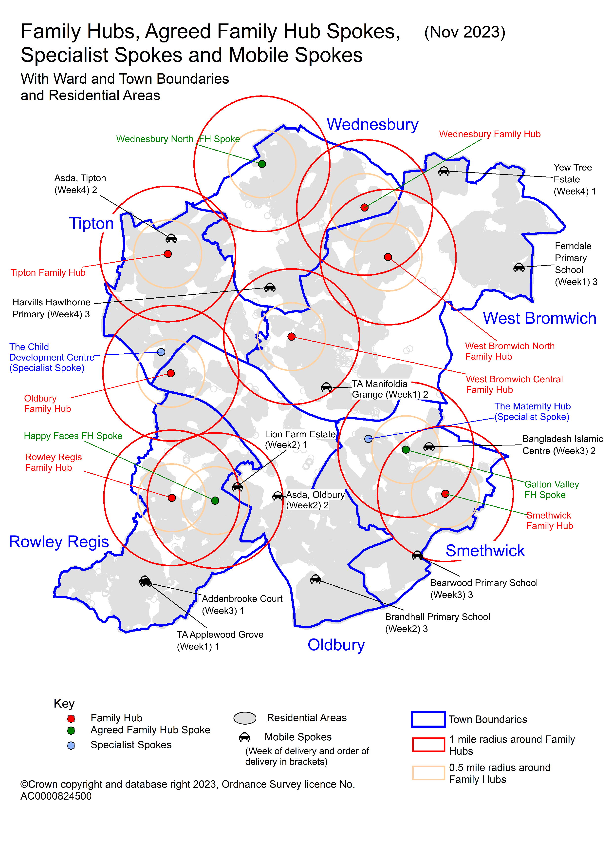

Slide 9

Family Hub Spoke Definitions

Slide 10
Family Hub Mobile Spokes
The mobile spoke will provide similar services to the “fixed” spoke
The mobile spokes will utilise the mobile library and youth bus
The mobile library spoke could operate for one day per week (Thursday), the cost would be £500 per month.
The mobile youth spoke could operate 2 twilight sessions a week at secondary schools, covering 8 schools each month. Linking to Violence reduction programme. Cost - £tbc per month
The mobile spoke will provide a targeted approach, providing a bridge to communities that may not traditionally reach out to services. Or where there is a larger distance to travel to access services.
Temporary Accommodations are in Cradley Health and West Bromwich. Both could be visited on a monthly basis.
Support provided by the mobile spoke will vary, based on the needs of the community it is visiting.
The mobile spokes could be operational from January 2024.

Slide 11
Example Route for Mobile Library Spoke
Example Month
Week One | Week Two | Week Three | Week Four
9.30am - 11.30am TA Applewood Grove, Cradley Heath, West Midlands, B64 6EW 12.30 – 2.30pm TA Manifoldia Grange, Coyne Rd, West Bromwich B70 7JU 3pm – 4.30pm Ferndale Primary School | 9.30 – 11.30am Lion Farm Estate 12.30 – 2pm Asda - Oldbury 3pm – 4.30pm Brandhall Primary School | 9.30 til 11.30am Addenbrooke Court Old Hill 12.30 til 2pm Bangladesh Islamic Centre -Smethwick 3pm - 4.30pm Bearwood Primary School | 9.30 – 11.30am Yew Tree Estate Wednesbury 12.30 – 2pm Asda – Tipton (lost city) 3pm - 4.30pm Harvills Hawthorne Primary
Suggested Services Health Visiting Housing Meet and Greet Cost of Living Advisor | Suggested Services •Meet and Greet •Library •Decca | Suggested Services •Meet and Greet •DA Advisor •Health Visitor | Suggested Services •PH officer • Housing •Meet and Greet

Slide 12
Example Route for Mobile Youth Spoke
Week One | Week Two | Week Three | Week Four
Services | Services | Services | Service

Slide 13
Family Hub Specialist Spokes
We aim to have two specialist family hub spokes:
Child Development Centre
This spoke will provide wraparound support for families with children with SEND
Wraparound support will initially include programmes for parents, housing support, cost of living advisors and health visiting.
A ‘no walls, no doors’ approach, as adopted by the Early Years and Child Development Centre.
Flexible outreach into family hubs. Key workers from the CDC will be linked to each of the family hubs. Supporting various early years sessions and working alongside staff to identify needs early and providing support.
Key Family hub staff trained to understand the SEND offer and support families to access services. This will be supported via workshops delivered to the family hub teams three times a year.
Clear pathways into family support and other services
Maternity Specialist Spoke
This is in a much earlier stage of development.

Slide 14
Benefits of becoming a Family Hub Spoke:
Spokes will be a key part of the family hub team and network Spokes will be able to shape services and support for families in their community, by attending the community network meetings. Each spoke will be able to submit an application for funding of approximately £tbc (across 2 years) to support provision of additional play opportunities for families with babies and or children under the age of 2. Spokes may be able to apply for small capital grants (maximum £5000 to include signage) to improve their building to benefit families. Each spoke will have a named Family Hub meet and greet worker who will support them and wrap around some services | Staff and volunteers will have access to free training to further support families Spokes will have access to free marketing via Family Hub newsletters, social media and website Spokes will have a stronger voice both locally and strategically Spokes will usually be the first choice for delivery of family hub activities and courses, especially where there is funding attached. Receive data on your service delivery and evaluation from parent / carer feedback. Each spoke will have new family hub signage There may be funding opportunities for running additional services

Slide 15
Expectations for Family Hub Spokes
Established provision that is sustainable and already providing high quality services for families Space is available for additional services to use Staff and volunteers can evidence a basic knowledge of safeguarding and working with children and families. The organisation is part of the Early Help partnership The spoke will be based in an area of need, which lacks services as identified by the needs assessment (not within a one mile radius of the main family hub or spoke see slide 7) unless it is a specialist spoke. Or the spoke can evidence that it meets the needs of a community that don’t currently access family hub. Priority will be given to provision that is open a minimum of 3 times a week and be able to open more when required including evenings and weekends Each spoke will have a sustainable plan to ensure services for families continue post March 25. Staff and volunteers are willing to attend further training linked to Family Hubs and Early Help Representative from the spoke will attend and contribute to their local community network Each spoke will receive a grant of up to £5000 to deliver and evaluate additional well being interventions that promote infant attachment and wellbeing until 31.3.26

Slide 16
Key Performance Indicators that Spokes would contribute to.
Key Performance Indicator | Expectation of Spoke
20% Increase in the number of families registered with the Family Hub (From Children's Centre's 22/23 baseline) by July 2024 | To support families to register for Family hub, clearly sharing the services and support available
Increase the percentage of children eligible for ELT that access their entitlement. (Number of children taking up ELT places as a percentage of the baseline figure for those entitled). | To promote ELT with families, supporting applications and finding childcare.
60% Parents will know how to access Family Hubs services by July 2024 (Via survey) | All staff and volunteers in the spoke understand the family hub offer and are able to signpost/ handhold families to access further support where needed
Uptake of FH Services is more reflective of community make-up (Current access data to be analysed to identify which communities aren't accessing services and to set target) by July 2024 | By completing registrations with families this data will be captured and analysed.
80% of service users will report positive experience of Family Hub Services by July 2024(Via survey) | Accessible, inclusive and welcoming to all families Staff and volunteers are able to attend Family Hub events and meetings
50% Increase in engagement by fathers/male carers (baseline to be captured from Children's Centres data) | Staff and volunteers to be knowledgeable on services and support available specifically for dads / male carers

Slide 17
Key Performance Indicators that Spokes would contribute to.
Key Performance Indicator | Expectation of Spoke
80% of families feel that pathways are clear and easy to navigate by July 2024 (to be captured by survey) | All family hub campaigns and pathways are displayed and promoted to families. Staff and volunteers are familiar with the pathways and able to target and share with families (for example healthy pregnancy pathway)
80% Families report positive, supporting relationships with Family Hub practitioners and peer supporters by July 2024 (baseline to be captured via survey) July 2023 | Accessible, inclusive and welcoming to all families Each spoke will be able to share data about the families attending and the services they are accessing or requesting access to.
10,000 families to access information and services via new website by March 2024 | To display and promote the Family Hub website To include a link to Family Hub website on the spoke website To include links to Family Hub face-book on the spoke face-book

Slide 18
Benefits of becoming part of the Family Hub Network:
Network members are a key part of the model Network members will be able to shape services and support for families in their community via the community network meetings Network members will have a named Family Hub meet and greet worker who will support them and keep them updated about local services and campaigns Network members will have access to free training to further support families. Network members will have access to free marketing via Family Hub newsletters, social media and website Network members will be able to join family hub meetings and events Each network member will receive a family hub network “sign” to display

Slide 19
Expectations for Family Hub Network Members
Established provision that is sustainable and already providing high quality services for families Staff and volunteers can evidence a basic knowledge of safeguarding and working with children and families. The organisation is part of the Early Help partnership Staff and volunteers are willing to attend further training linked to Family Hubs and Early Help Representative from the network organisation will be welcome to attend and contribute to their local community network

Slide 20
Key Performance Indicators that Network members could contribute to.
Key Performance Indicator | Contribution from Networks
20% Increase in the number of families registered with the Family Hub (From Children's Centre's 22/23 baseline) by July 2024 | To support families to register for Family hub, sharing the services and support available
Increase the percentage of children eligible for ELT that access their entitlement. | To promote ELT with families, supporting applications and finding childcare.
60% Parents will know how to access Family Hubs services by July 2024 (Via survey) | All network staff and volunteers understand the family hub offer and able to signpost/ handhold families to access further support
Uptake of FH Services is more reflective of community make-up (Current access data to be analysed to identify which communities aren't accessing services and to set target) by July24 | By supporting family registrations with families this data will be captured and analysed.
80% of service users will report positive experience of Family Hub Services by July 2024(Via survey) | Accessible, inclusive and welcoming to all families. Staff/ volunteers encouraged to attend Family Hub events and meetings
50% Increase in engagement by fathers/male carers (baseline to be captured from Children's Centres data) | Staff and volunteers to be knowledgeable on services and support available specifically for dads / male carers
80% of families feel that pathways are clear and easy to navigate by July 2024 (to be captured by survey) | All family hub campaigns and pathways are displayed and promoted to families.
80% Families report positive, supporting relationships with Family Hub practitioners and peer supporters | Accessible, inclusive and welcoming to all families
10,000 families to access information and services via Family Hub website by March 2024 | To display and promote the Family Hub website

Slide 21
Next Steps and Timeline
Key Dates | Actions
22nd November 23 | The Family Hub model to be shared and discussed at Family Hub Implementation group
11th December 23 | The Family Hub model to be signed off at Family Hub Programme board
December 23 to January 24 | Three Satellite sites to be rebranded
11th January 24 | Mobile Library spoke to commence
18th December to 17th January 24 | Several webinars / drop ins to take place during December / January to all potential organisations considering being a spoke.
26th January 24 | All organisations submit an expression of interest
30th January 24 | The expressions of interest to be a spoke will be shared at Family Hub Implementation group sub group
29th January 24 | Successful Spoke applications agreed and signed off
February 2024 | One to one meetings with successful spoke applicants
March 24 | Operationalising spokes and funding awarded

Slide 22

Thank you for your time we welcome your questions

