Slide 1

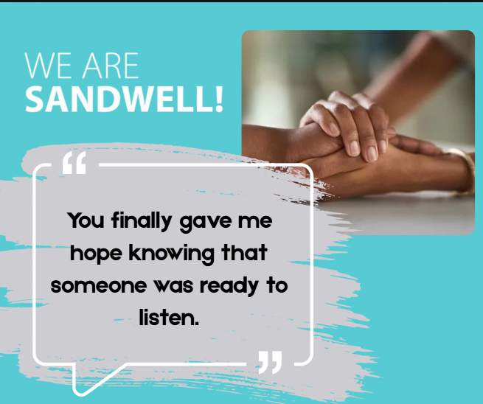

Case study: Social Worker feedback
March 2025
We received lovely feedback for one of our Social Worker’s from a resident in March:
I would like to take this opportunity in thanking you so much for all the support and compassion you have given me during your time as a Social Worker for Sandwell Social Services.
As you know from my personal lifestyle, I have faced many challenges due to my personal lifestyle , sexuality, and disabilities. Working with you finally gave me hope knowing that someone was ready to listen and actually understand how I’m feeling coming from an ethnic minority background.

Slide 2
Case study: Social Worker feedback
March 2025
You always kept me informed and did what you said, without hesitation. Always remained professional, kind, compassionate caring which helped with my anxiety.
You will be a great loss to Sandwell Council and the workforce there and at the same time I’m sure you have also gained and have made amazing memories and experiences
You will honestly be an amazing asset to where your professional pathway takes you and I wish to once again give you a massive thank you from myself and my husband for everything you have done. Honestly, words can’t tell you just how much.

