Slide 1

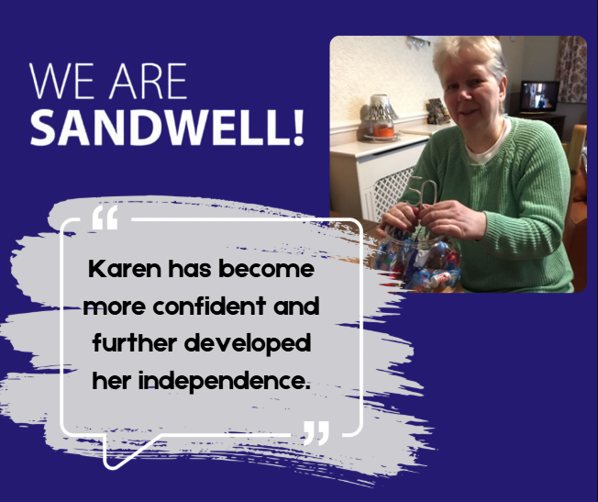

Case study: Settling into Shared Lives
March 2025
Karen started receiving Shared Lives Respite support in January 2023. She was matched with a Shared Lives Carer who shared her interests, hobbies and preferences.
During her respite stays Karen has enjoyed visits to the cinema, shopping trips and completed arts and craft activities to make birthday gifts.
Since beginning her Shared Lives journey, Karen has become more confident and further developed her independence.

Slide 2
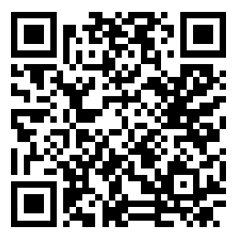

Case study: Settling into Shared Lives
March 2025
Karen has discussed her future aspirations with her Shared Lives Carer, and they have planned how these can be achieved. They include picnics in the park in the summer months and visiting Lichfield town.
Find out more
www.sandwell.gov.uk/disability/shared-lives-scheme

